Slide 1

CS302 Design and Analysis of Algorithms
Muhammad sohail afzal

Slide 2
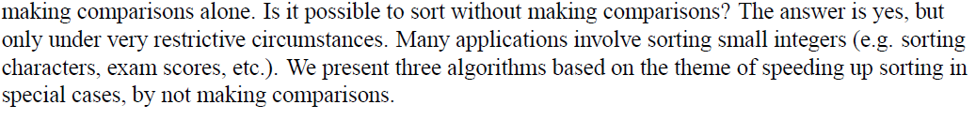
Linear Time Sorting – Non Comparison Based
We noticed in previous sorting techniques the most we can reduce sorting time to is “nlogn” but all the approaches were comparison based approaches. If we want faster sorting time than “nlogn” then it is not possible through comparison approach. We cannot reduce more time by

Slide 3
Linear Time Sorting – Non Comparison Based
There are three types of linear time sorting algorithms that are based on non-comparison strategy :
Counting Sort
Bucket Sort / Bin Sort
Radix Sort

Slide 4
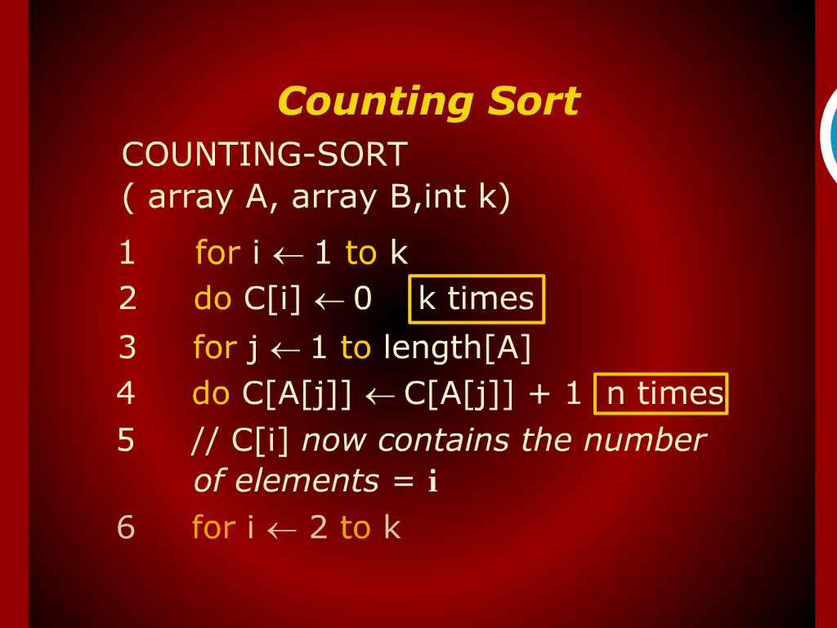
Counting Sort

Slide 5
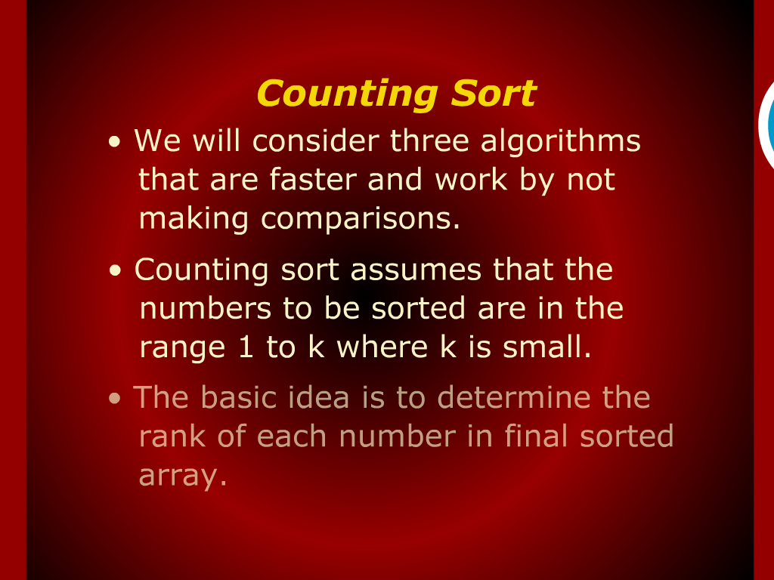
Counting Sort

Slide 6
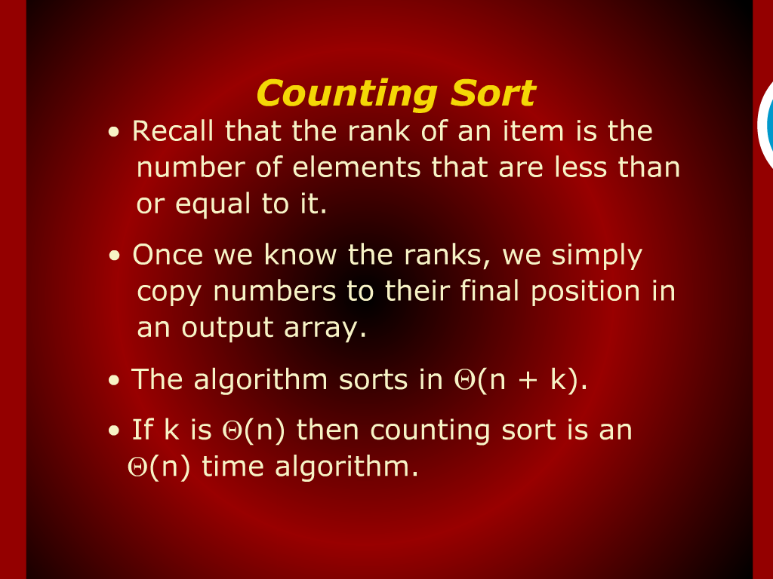
Counting Sort

Slide 7
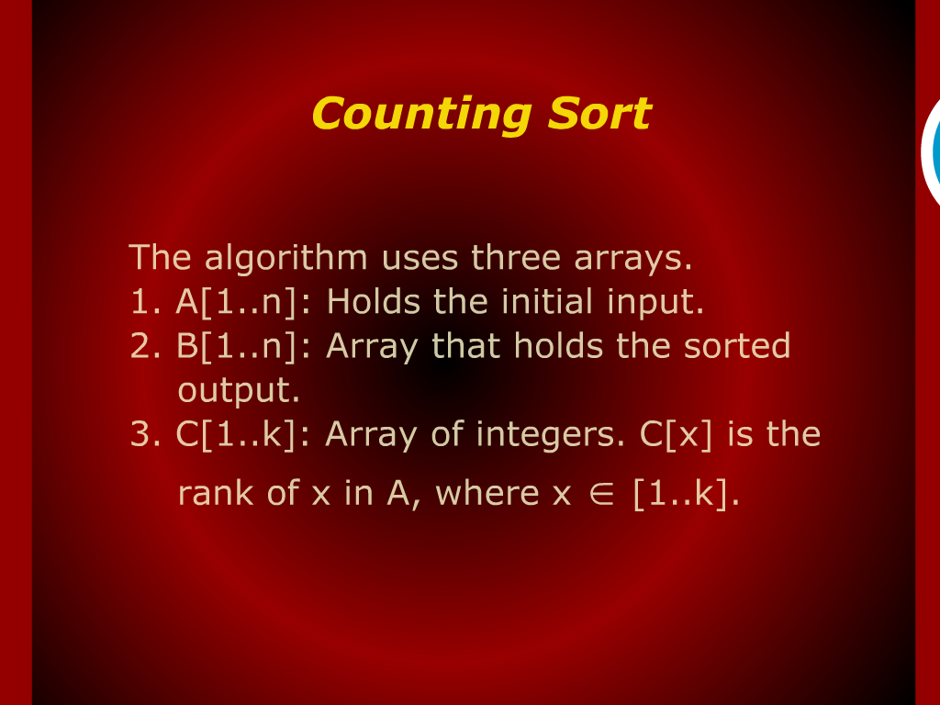
Counting Sort

Slide 8
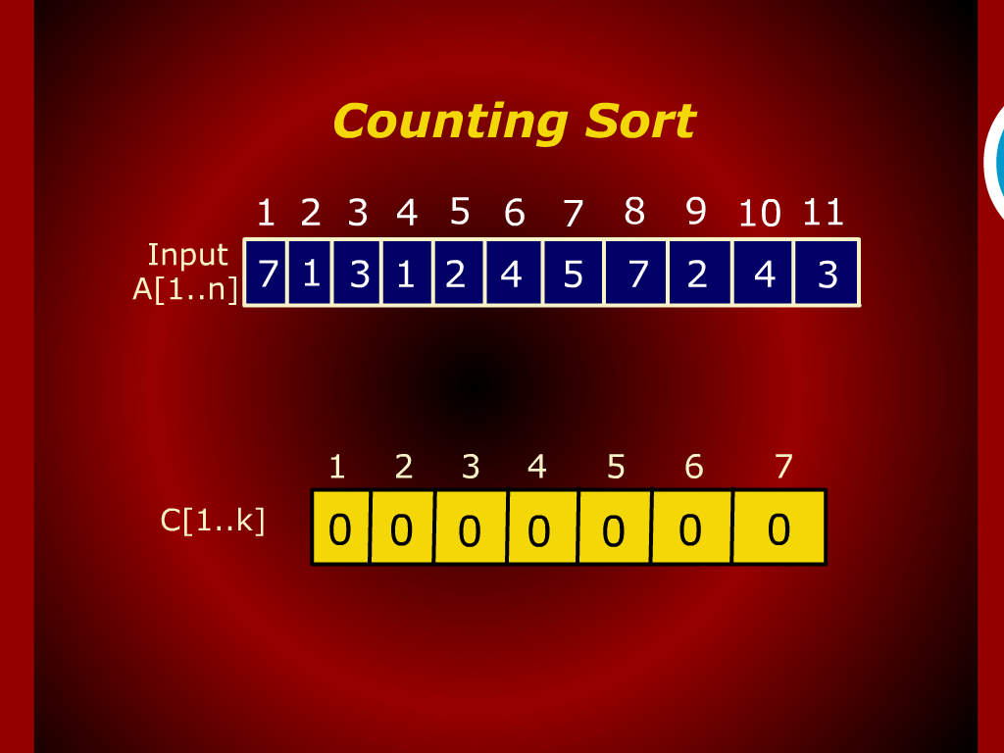
Counting sort

Slide 9
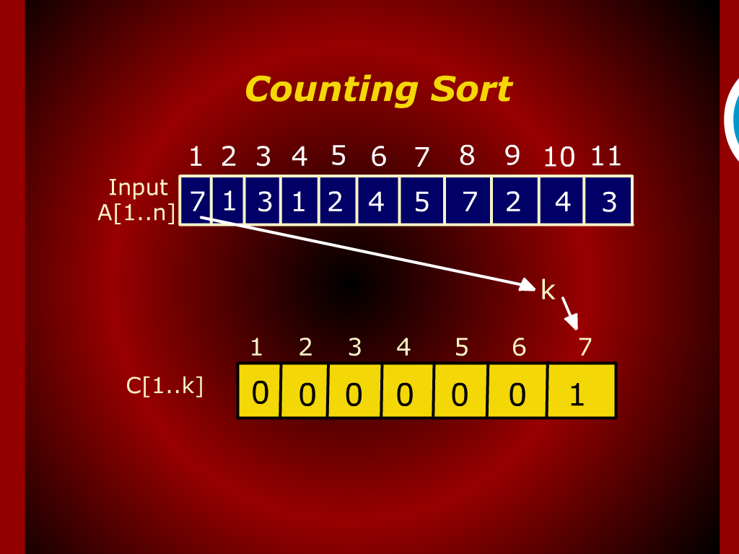
Counting sort

Slide 10
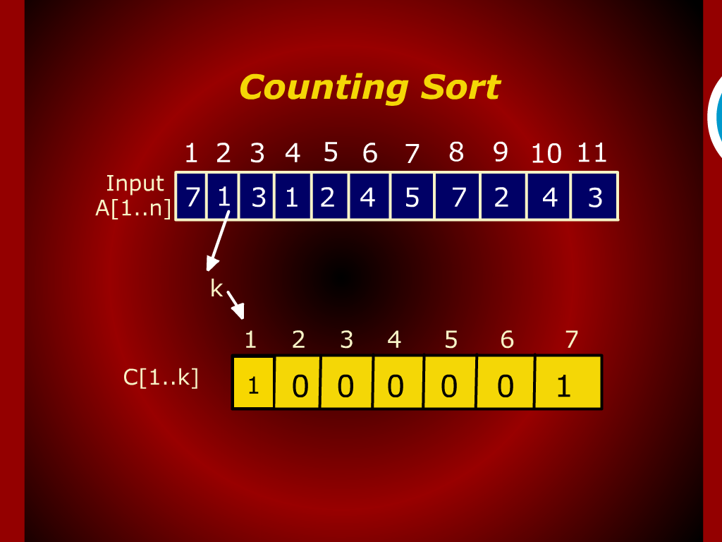
Counting sort

Slide 11
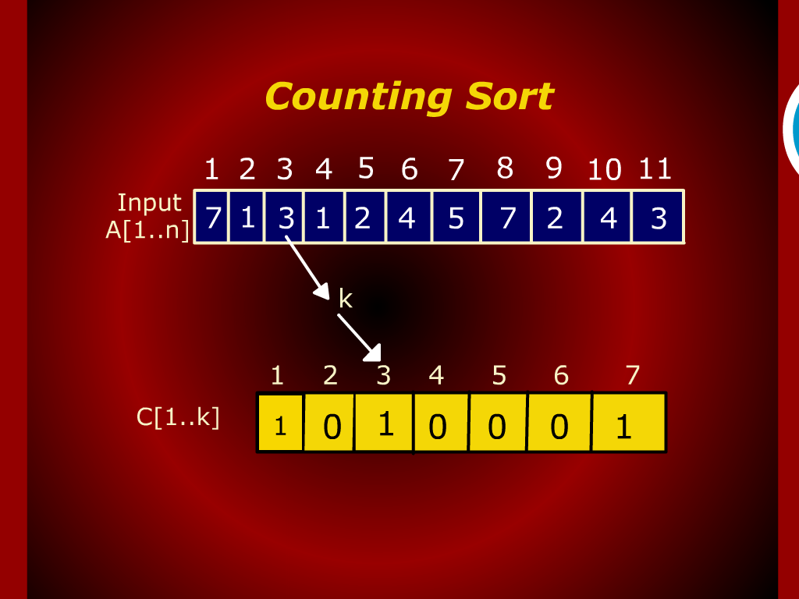
Counting sort

Slide 12

Counting sort

Slide 13
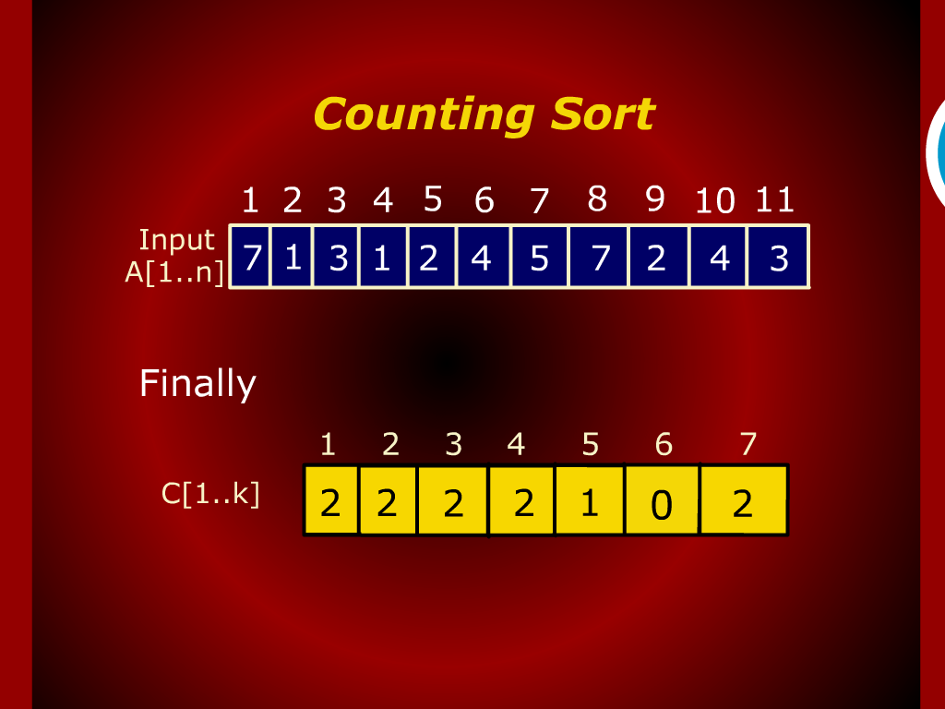
Counting sort

Slide 14
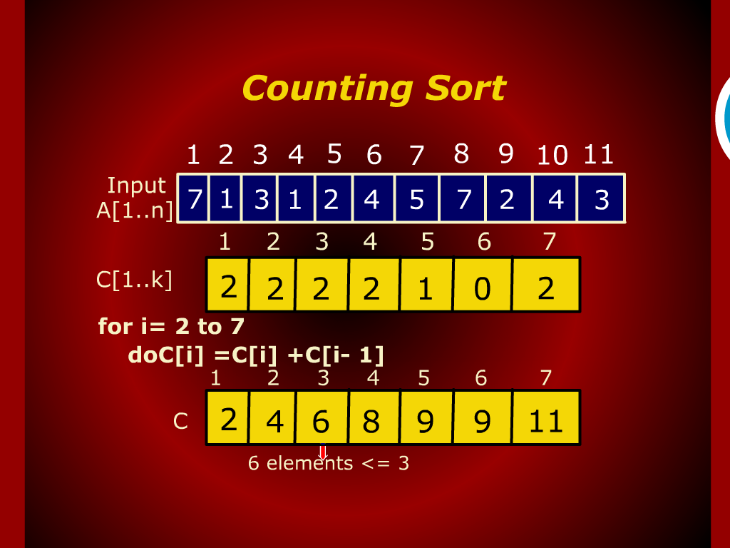
Counting sort

Slide 15
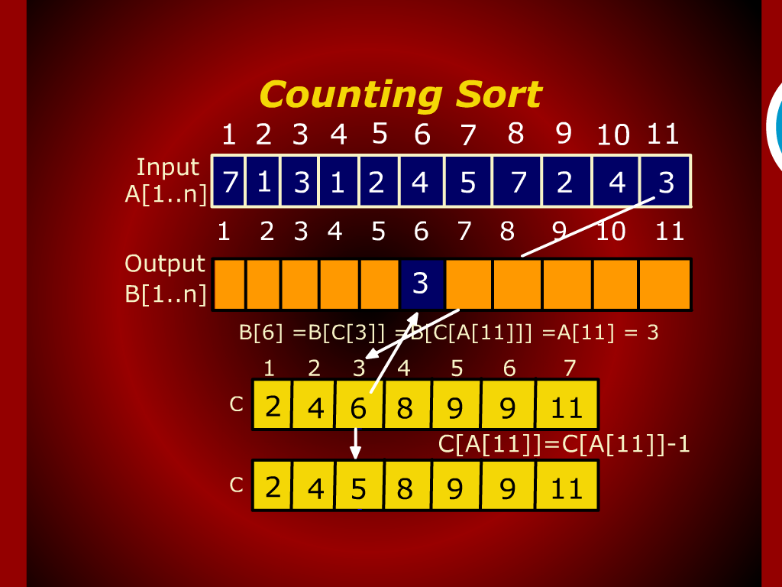
Counting sort

Slide 16
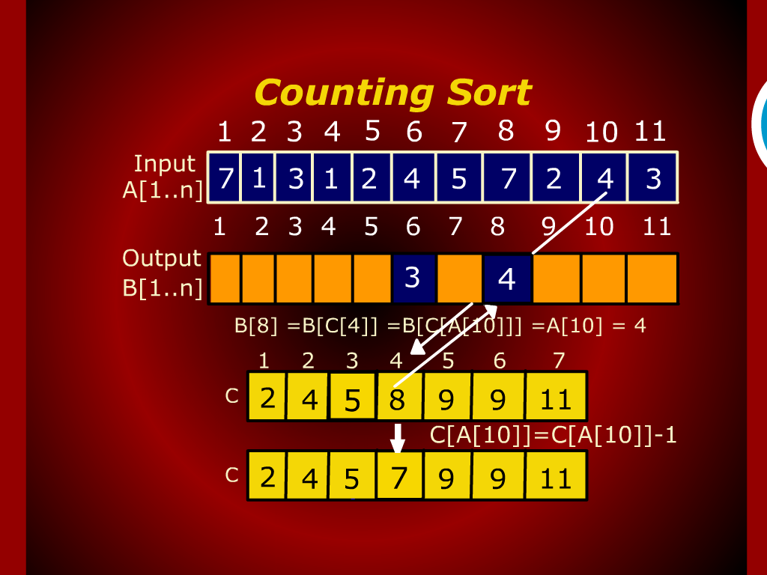
Counting sort

Slide 17
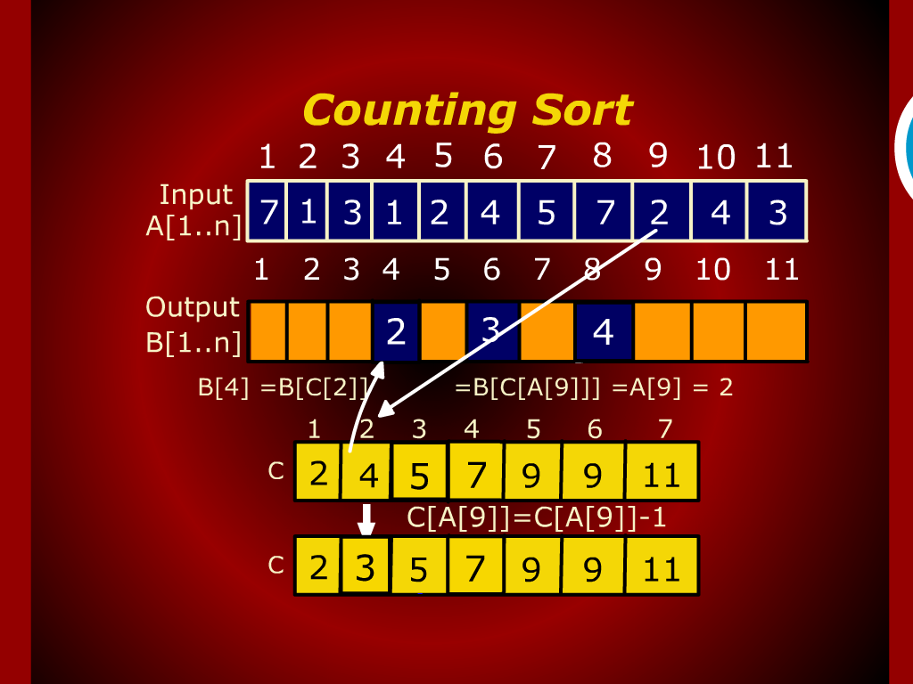
Counting sort

Slide 18
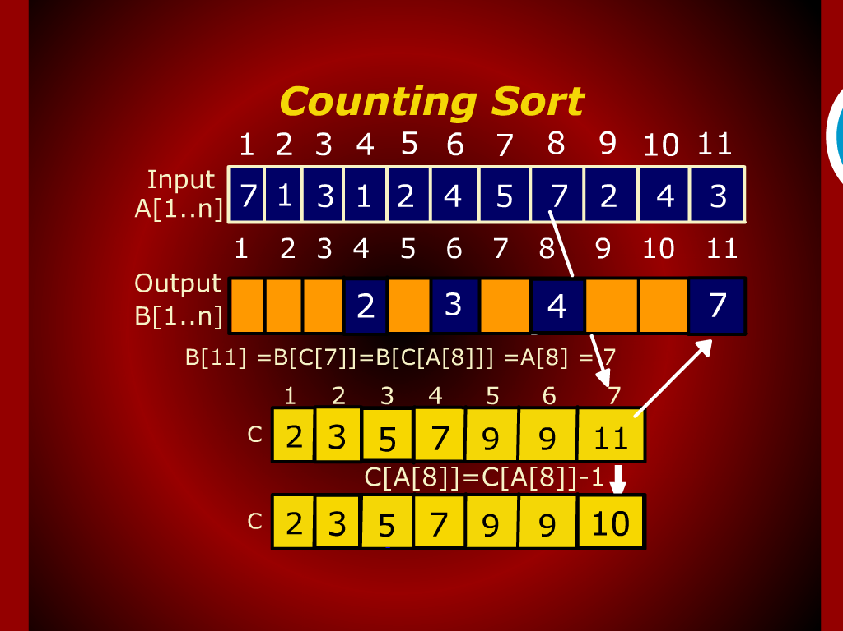
Counting sort

Slide 19
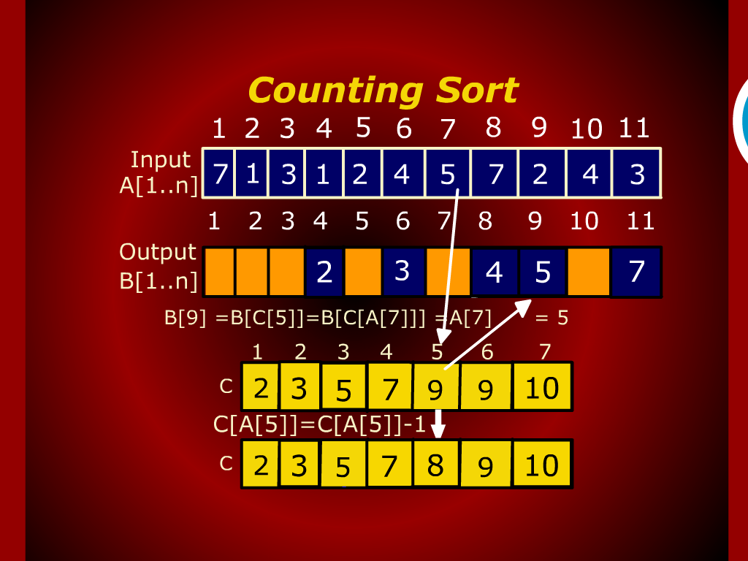
Counting sort

Slide 20
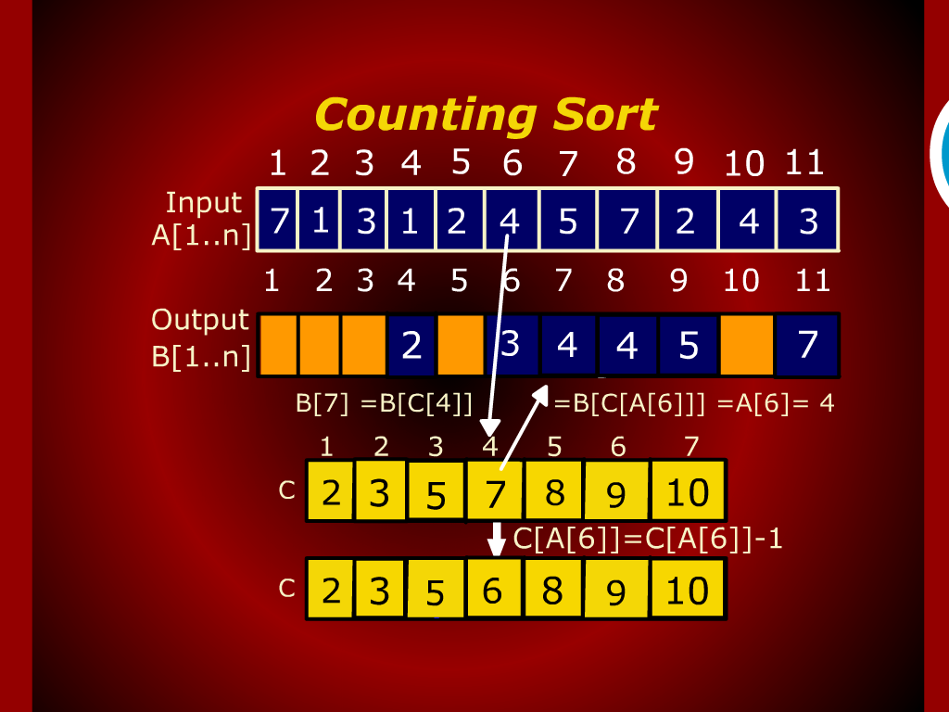
Counting sort

Slide 21
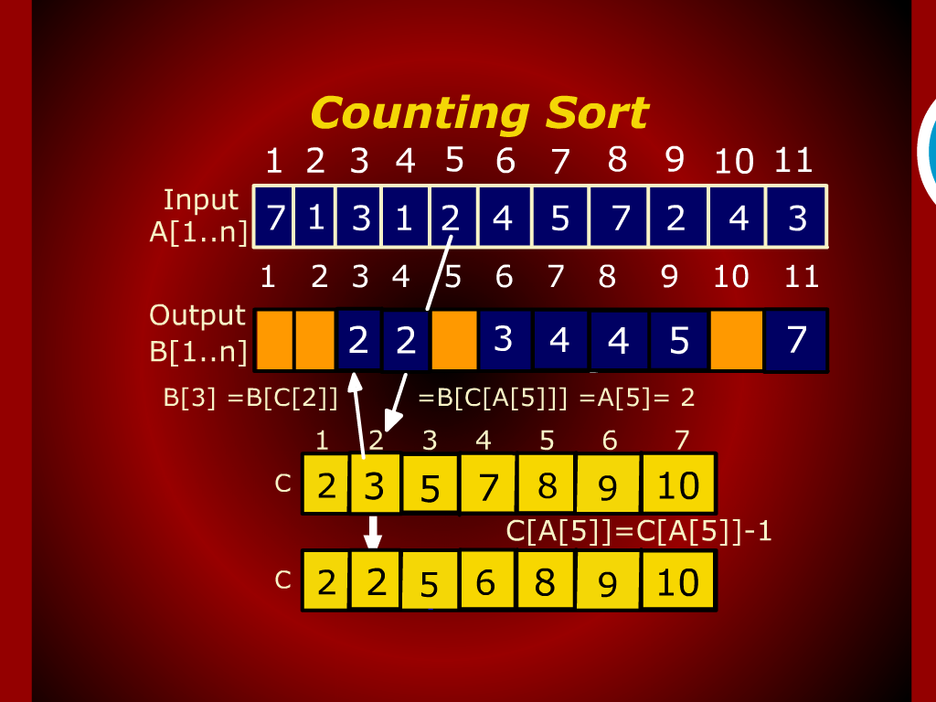
Counting sort

Slide 22
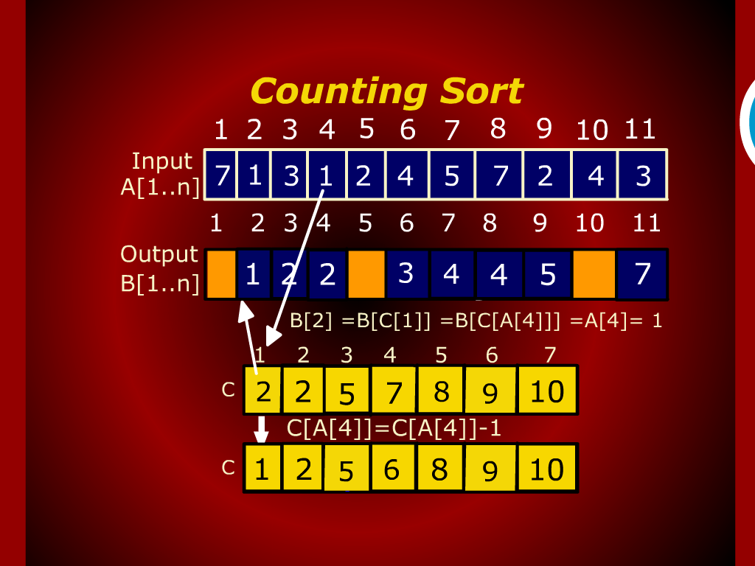
Counting sort

Slide 23
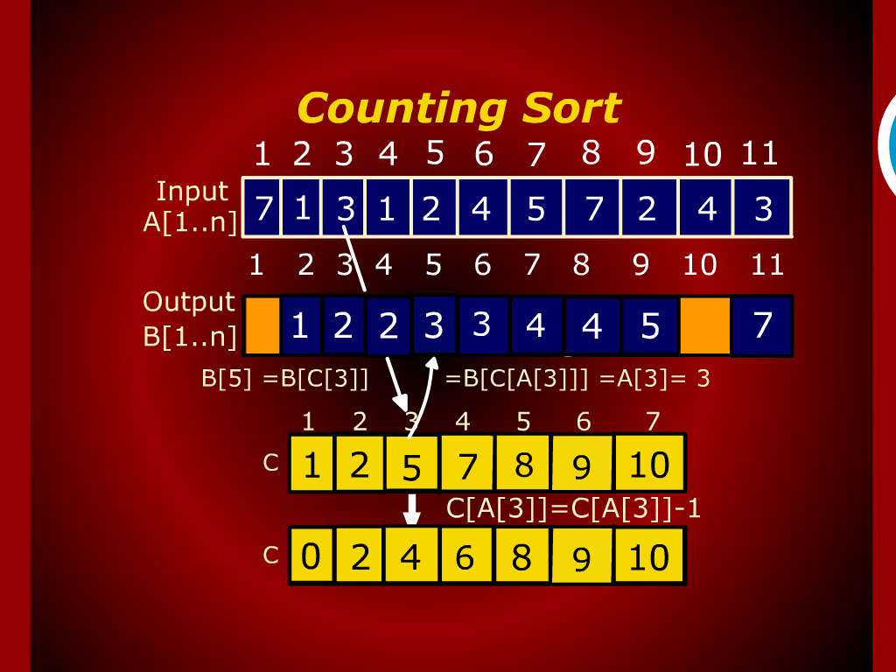
Counting sort

Slide 24
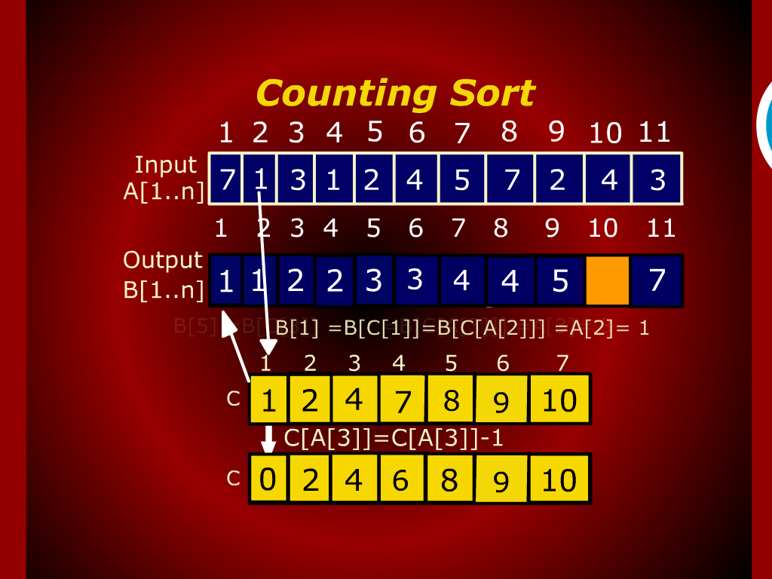
Counting sort

Slide 25
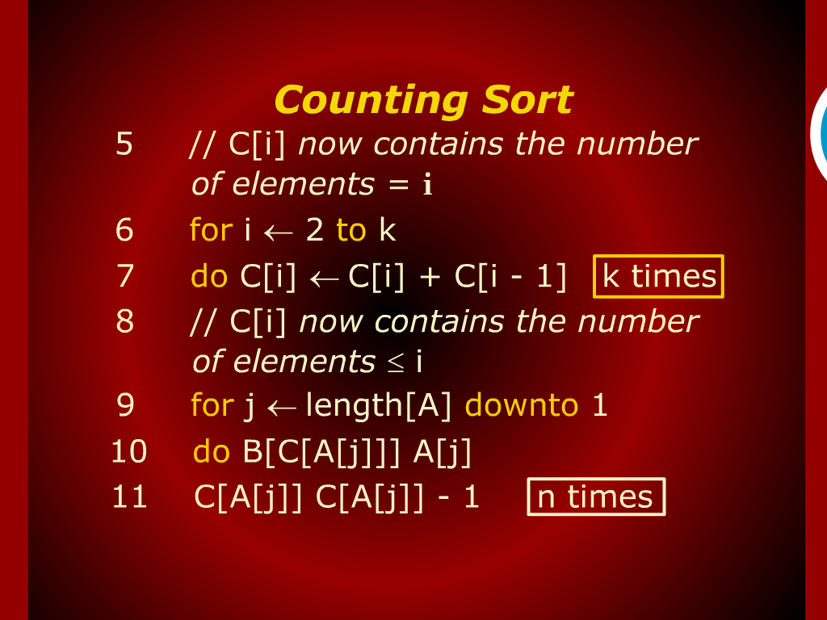
Counting sort

Slide 26
Bucket Sort
Assumptions :
Input elements are uniformly distributed over [0,1]

Slide 27
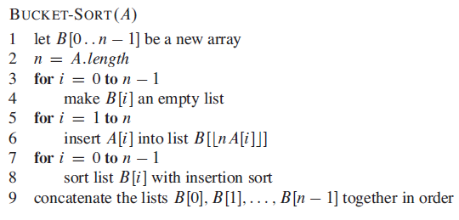
Bucket Sort

Slide 28
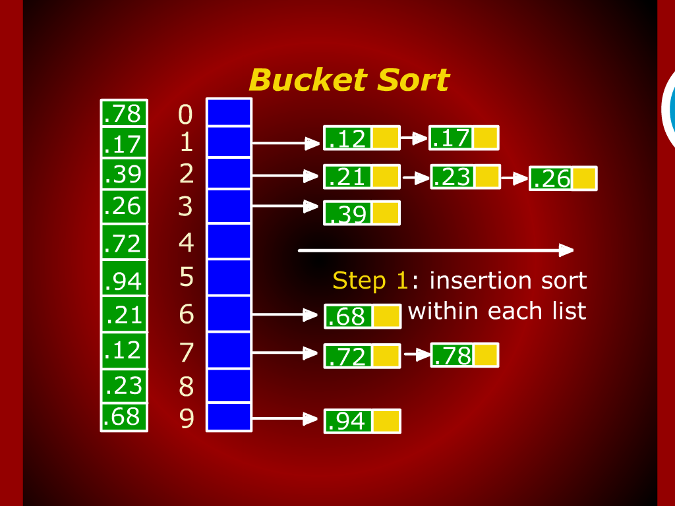
Bucket Sort

Slide 29
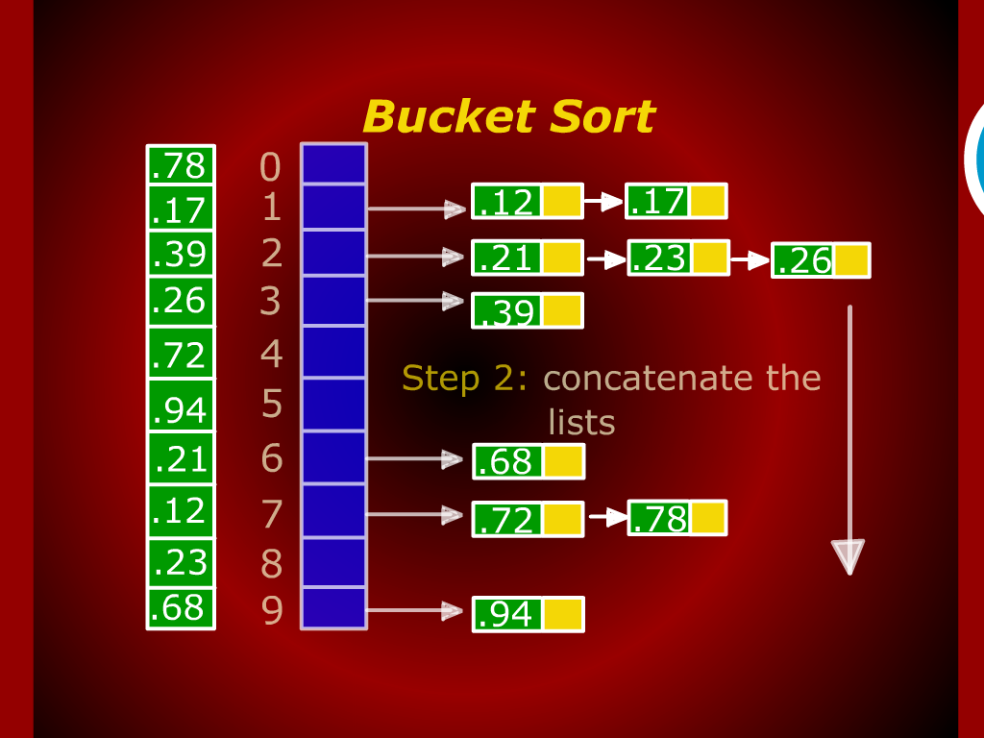
Bucket Sort

Slide 30
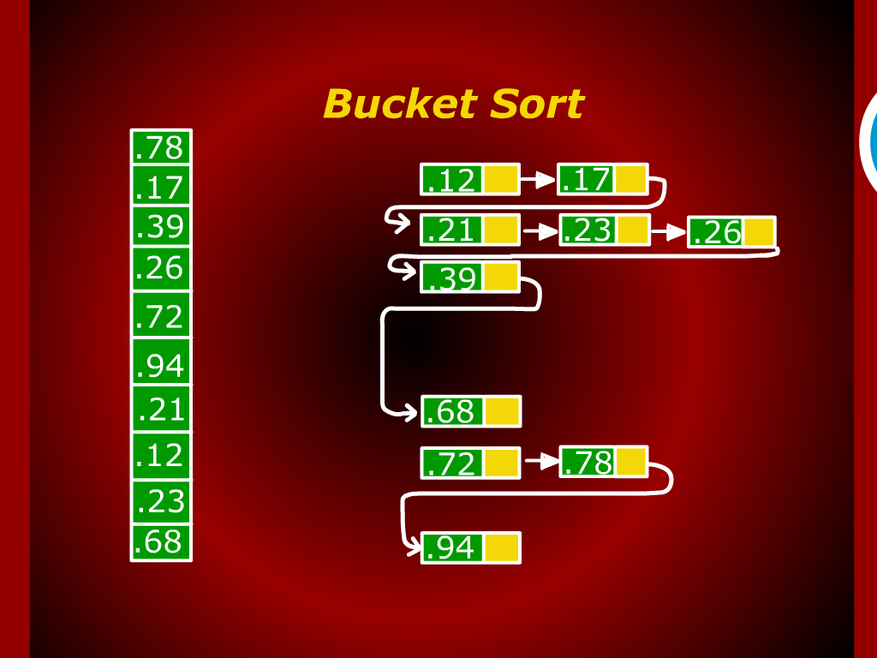
Bucket Sort

Slide 31
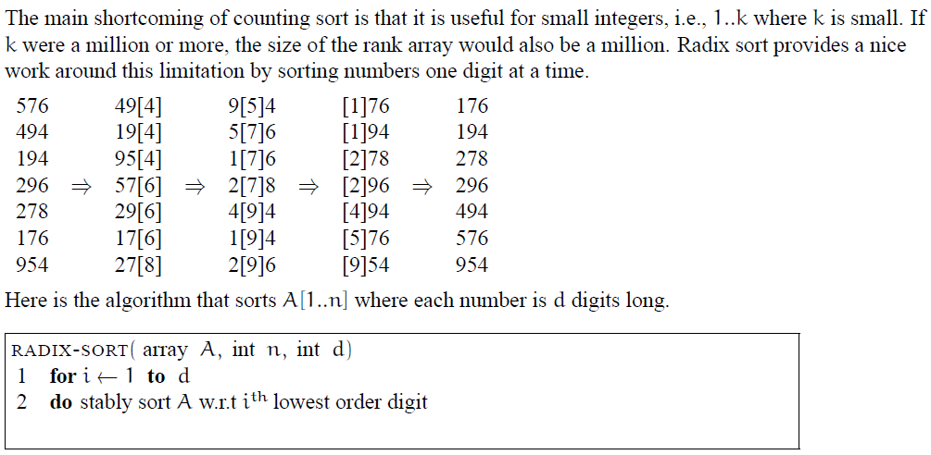
Radix Sort

Slide 32
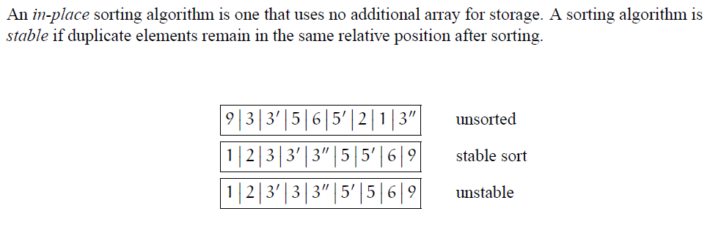
In-Place and Stable Algorithms

Slide 33
